Slide 1
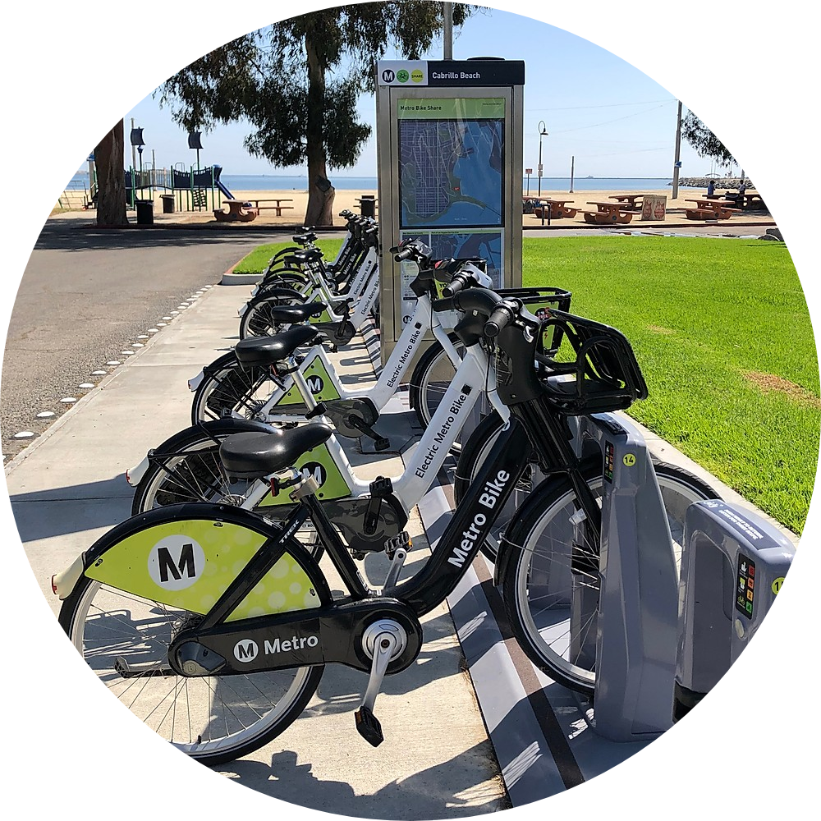

Demand prediction in a bike-sharing system using machine learning techniques
Ashish Rawat
Masters in Data Analytics
X18185801
Supervisor:
Paul Stynes

Slide 2
Introduction
Bike-sharing system is a sustainable mode of transportation made available to the public at low cost.
It allows the user to lent a bike, from a bike station and return it to the bike station near the destination.
The city-wide installation of bike stations facilitates the accessibility.
Challenges in a bike-sharing system
Unavailability of bikes to lent from bike station
Unavailability of docks to park bikes at the bike station.

Slide 3
Research Question
Can machine learning techniques be utilized to predict the demands for bikes and docks at a bike station? Can the neighbouring bike stations influence the demands prediction for a bike station?
Objectives
Data Transformation of original bike-share data.
Data preparation for each machine learning model.
Training and optimizing machine learning models; ARIMA, LSTM, STGCN and TAGCN.
Evaluation of the models for two-time intervals (30 min and 60 min); RMSE, MSE and MAE

Slide 4

Data Collection
Metro Bike-Share system established in Los Angeles, USA.
Metro Bike Trip csv files
(5 million bike trips)
Metro Bike Station detail csv file
Google Drive

Slide 5
ARIMA
STGCN
Methodology
LSTM
TAGCN

Slide 6




Implementation
1. Create time intervals and transform the original data.
2. Data Preparation follows two processes:
Process 1 for ARIMA and LSTM model
Process 2 for STGCN and TAGCN model
Time Interval data
Station Detail Data
Data
Processing
Data
Processing
1 Bike Station
Dataframe
Graph Structured Data
Total Transformed data
Individual Transformed Data

Slide 7
Evaluation
Evaluation Metrics: MSE, MAE and RMSE.
The evaluation of the model was done for two-time intervals (30 min and 60 min).
1. Evaluation for 30 min interval
Model | MSE | MAE | RMSE
ARIMA | 1.12 | 0.78 | 1.06
LSTM | 0.83 | 0.56 | 0.91
STGCN | 0.74 | 0.58 | 0.76
TAGCN | 1.01 | 0.54 | 0.73
Model | MSE | MAE | RMSE
ARIMA | 1.16 | 0.82 | 1.08
LSTM | 0.87 | 0.60 | 0.94
STGCN | 0.094 | 0.13 | 0.37
TAGCN | 0.48 | 0.36 | 0.60
Bikes Demand
Docks Demand

Slide 8
Evaluation
2. Evaluation for 60 min interval
Model | MSE | MAE | RMSE
ARIMA | 3.26 | 1.38 | 1.81
LSTM | 2.68 | 1.10 | 1.63
STGCN | 8.26 | 1.79 | 1.34
TAGCN | 3.63 | 1.26 | 1.12
Model | MSE | MAE | RMSE
ARIMA | 3.37 | 1.46 | 1.83
LSTM | 2.42 | 1.09 | 1.55
STGCN | 0.70 | 0.54 | 0.73
TAGCN | 1.78 | 0.73 | 0.86
Bikes Demand
Docks Demand

Slide 9
Conclusion
STGCN model performed comparatively better than the other models for 30 min intervals.
A similar trend of high MSE value can be observed for bikes and docks demand prediction for bike data with 60 min interval.
The low RMSE of STGCN in docks demand could be the result of smaller variation in the data.
The use machine learning for bikes and docks demand prediction in a bike-sharing system has presented satisfactory results and highlighted the importance of uniformity in the demands in the time intervals was identified.
With the addition neighbouring station as a factor, better results was obtained for shorter interval.
Moreover, with addition of external factors can help in more efficient models.

Slide 10
Thank You

